Slide 1
USER DATAGRAM PROTOCOL & TRANSMISSION CONTROL PROTOCOL
USER DATAGRAM
UDP SERVICES
TCP SERVICES
SEGMENT

Slide 2
The User Datagram Protocol (UDP)
is a connectionless, unreliable transport protocol.
It does not add anything to the services of IP except for providing process-to-process communication instead of host-to-host communication.
If UDP is so powerless, why would a process want to use it?
UDP is a very simple protocol using a minimum of overhead.
If a process wants to send a small message and does not care much about reliability, it can use UDP.
Sending a small message using UDP takes much less interaction between the sender and receiver than using TCP.

Slide 3
User Datagram
UDP packets, called user datagrams, have a fixed-size header of 8 bytes made of four fields, each of 2 bytes (16 bits).
The first two fields define the source and destination port numbers.
The third field defines the total length of the user datagram, header plus data.
The 16 bits can define a total length of 0 to 65,535 bytes. However, the total length needs to be less because a UDP user datagram is stored in an IP datagram with the total length of 65,535 bytes.
The last field can carry the optional checksum.

Slide 4
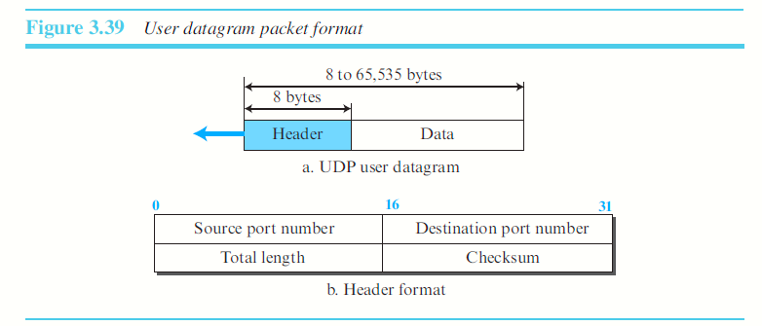
The following is the contents of a UDP header in hexadecimal format. CB84000D001C001C
a. What is the source port number? CB84 - 52100
b. What is the destination port number? 000D - 13
c. What is the total length of the user datagram? 001C – 28BYTES
d. What is the length of the data? 28 BYTES-8BYTES – 20 BYTES
e. Is the packet directed from a client to a server or vice versa?
f. What is the client process?

Slide 5
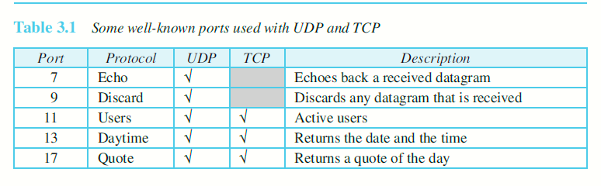
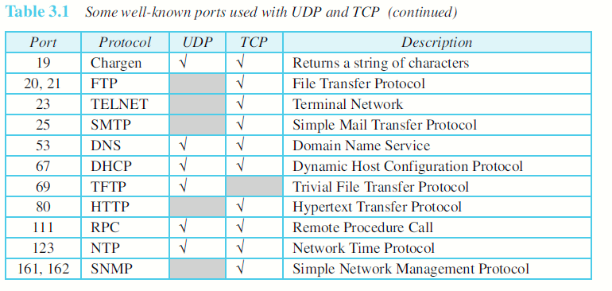

Slide 6
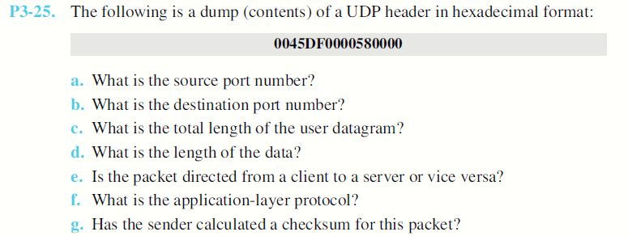

Slide 7
UDP SERVICES
Process-to-Process Communication
UDP provides process-to-process communication using socket addresses, a combination of IP addresses and port numbers.
Connectionless Services
Each user datagram sent by UDP is an independent datagram.
No relationship between the different user datagrams even if they are coming from the same source process and going to the same destination program.
The user datagrams are not numbered.
The process that uses UDP cannot send a stream of data to UDP and expect UDP to chop them into different, related user datagrams.
Instead each request must be small enough to fit into one user datagram.

Slide 8
No Flow Control:
The lack of flow control means that the process using UDP should provide for this service.
No error control mechanism in UDP except for the checksum:
The process using UDP should provide for this service.
No Congestion control:
Does not provide congestion control.
UDP assumes that the packets sent are small and sporadic and cannot create congestion in the network.
Queuing:
queues are associated with ports.
At the client site, when a process starts, it requests a port number from the operating system.
Multiplexing and De-multiplexing
Encapsulation and De-capsulation

Slide 9
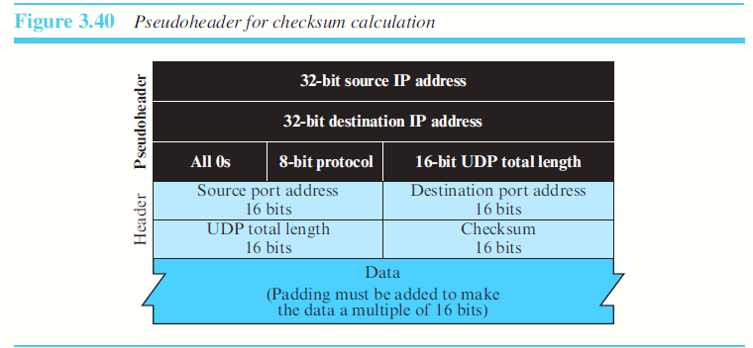
UDP checksum calculation includes three sections:
a pseudo-header
the UDP header and
the data coming from the application layer.

Slide 10
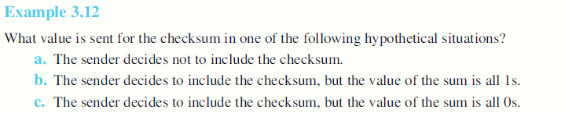

Slide 11
TRANSMISSION CONTROL PROTOCOL (TCP)
Connection-oriented, reliable protocol.
TCP explicitly defines connection establishment, data transfer, and connection teardown phases to provide a connection-oriented service.
TCP uses a combination of GBN and SR protocols to provide reliability.
To achieve this goal, TCP uses checksum (for error detection), retransmission of lost or corrupted packets, cumulative and selective acknowledgments, and timers.

Slide 12
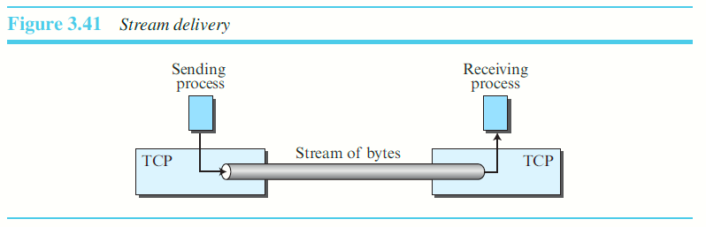
TCP SERVICES
Process-to-Process Communication
Stream Delivery service:
TCP allows the sending process to deliver data as a stream of bytes and allows the receiving process to obtain data as a stream of bytes.
The sending process produces (writes to) the stream and the receiving process consumes (reads from) it.

Slide 13
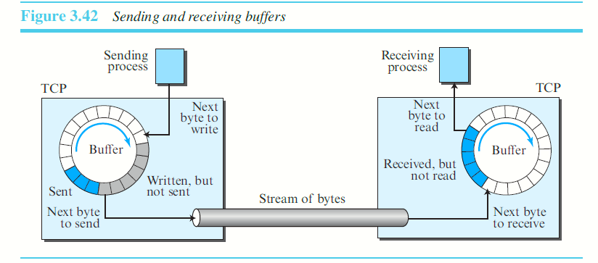
Sending and Receiving Buffers
The sending and the receiving processes may not necessarily write or read data at the same rate, TCP needs buffers for storage.
There are two buffers, the sending buffer and the receiving buffer, one for each direction.

Slide 14
At the sender, the buffer has three types of chambers.
The white section contains empty chambers that can be filled by the sending process (producer).
The colored area holds bytes that have been sent but not yet acknowledged. The TCP sender keeps these bytes in the buffer until it receives an acknowledgment.
The shaded area (greyed) contains bytes to be sent by the sending TCP. TCP may be able to send only part of this shaded section. This could be due to the slowness of the receiving process, or congestion in the network.

Slide 15
Operation of the buffer at the receiver is simpler.
The circular buffer is divided into two areas (shown as white and colored).
The white area contains empty chambers to be filled by bytes received from the network.
The colored area bytes that can be read by the receiving process.
After the bytes in the colored chambers are acknowledged, the chambers are recycled and available for use by the sending process.
When a byte is read by the receiving process, the chamber is recycled and added to the pool of empty chambers

Slide 16
Segments
TCP groups a number of bytes together into a packet called a segment. Why???
TCP adds a header to each segment and delivers the segment to the network layer for transmission.
The network layer, as a service provider for TCP, needs to send data in packets, not as a stream of bytes
The segments are encapsulated in an IP datagram and transmitted.

Slide 17
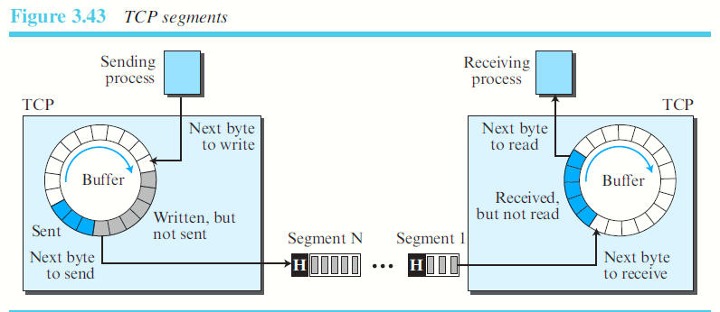

Slide 18
Full-Duplex Communication:
Data can flow in both directions at the same time.
Each TCP endpoint then has its own sending and receiving buffer, and segments move in both directions
Multiplexing and De-Multiplexing:
Connection-Oriented Service:
Three phases occur:
The two TCP’s establish a logical connection between them.
Data are exchanged in both directions.
The connection is terminated.
Reliable:

Slide 19
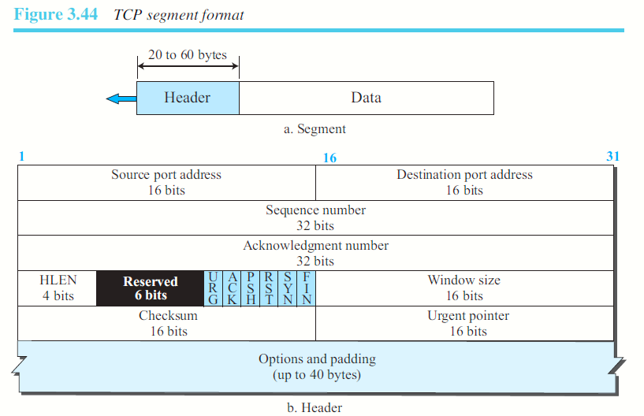

Slide 20
Source port Address: 16 bits
Destination port Address:16 bits
Sequence Number: The sequence number tells the destination which byte in this sequence is the first byte in the segment.
During connection establishment each party uses a random number generator to create an initial sequence number (ISN), which is usually different in each direction
Acknowledgment Number:
If the receiver of the segment has successfully received byte number x from the other party, it returns x + 1 as the acknowledgment number.
Acknowledgment and data can be piggybacked together.
Header Length: 4-bit field indicates the number of 4-byte words in the TCP header.
The length of the header can be between 20 and 60 bytes.
Therefore, the value of this field is always between 5 (5 × 4 = 20) and 15 (15 × 4 = 60)

Slide 21
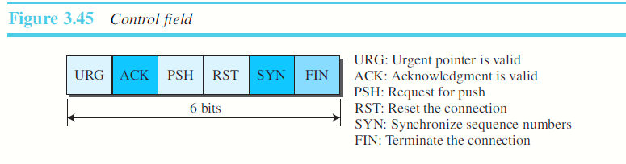
Control
One or more of these bits can be set at a time. These bits enable flow control, connection establishment and termination, connection abortion, and the mode of data transfer in TCP.
Window size:
This field defines the window size of the sending TCP in bytes.
The length of this field is 16 bits, which means that the maximum size of the window is 65,535 bytes

Slide 22
Urgent pointer:
This 16-bit field, which is valid only if the urgent flag is set, is used when the segment contains urgent data.
It defines a value that must be added to the sequence number to obtain the number of the last urgent byte in the data section of the segment.
Options:
There can be up to 40 bytes of optional information in the TCP header

Slide 23
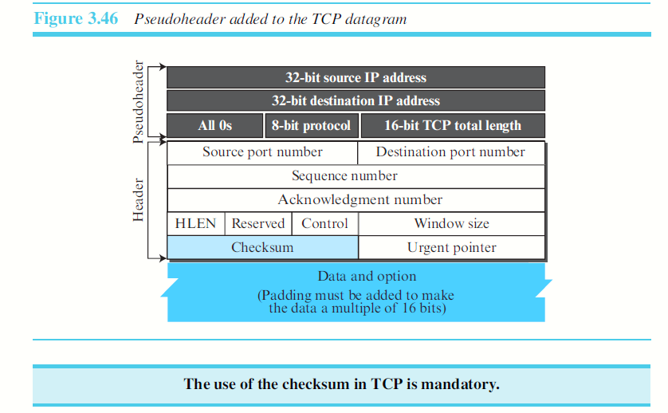

Slide 24
Encapsulation:
Data that is received from the AL, encapsulated in a segment – encapsulated in an IP datagram- in turn is encapsulated in the Data link layer.

